Slide 1
Programming with Python
Day 2

Slide 2
The Software Development Process
Software development: process of planning and organizing a program
Several approaches; one is the waterfall model
Modern software development is usually incremental and iterative
Analysis and design may produce a prototype of a system for coding, and then back up to earlier phases to fill in more details after some testing

Slide 3
The Software Development Process

Slide 4
The Software Development Process
Programs rarely work as hoped the first time they are run
Must perform extensive and careful testing
The cost of developing software is not spread equally over the phases

Slide 5
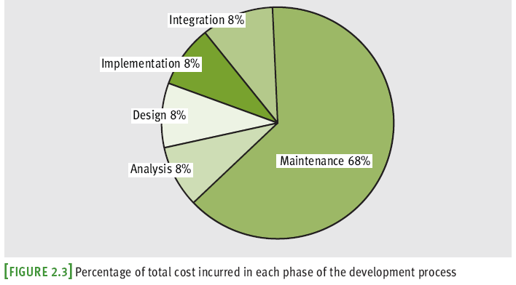
The Software Development Process

Slide 6
Case Study: Income Tax Calculator
Each year nearly everyone faces the unpleasant task of computing his or her income tax return
If only it could be done as easily as suggested in this case study
We begin with the request:
a program that computes a person’s income tax

Slide 7
Case Study: Analysis
All taxpayers are charged a flat tax rate of 20%
Taxpayers are allowed $10,000 standard deduction
For each dependent, taxpayer is allowed additional $3000 deduction
Gross income must be entered to nearest penny
Income tax is expressed as decimal number

Slide 8
Case Study: Design
Algorithms are often written in a somewhat stylized version of English called pseudocode
Pseudocode for our income tax program:
Input the gross income and number of dependents
Compute the taxable income using the formula
Taxable income = gross income - 10000 - (3000 * number of dependents)
Compute the income tax using the formula
Tax = taxable income * 0.20
Print the tax

Slide 9
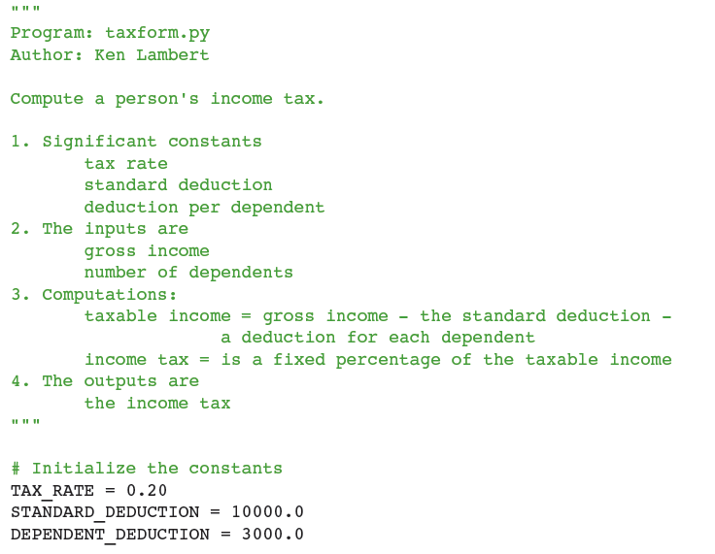

Case Study: Implementation (Coding)

Slide 10
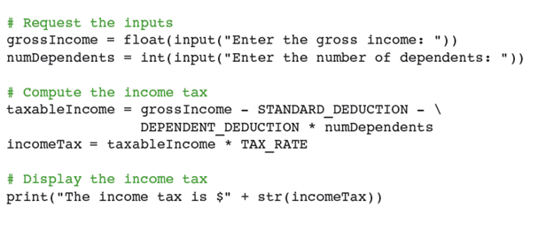
Case Study: Implementation (Coding, continued)

Slide 11
Case Study: Testing
Even if there are no syntax errors, the program could still have a logic error or a design error
May use a test suite to test if program is correct
Note that you will learn about SDLC in grater detail in the WA210 course.

Slide 12
Python Strings, Assignment, and Comments
Text processing is by far the most common application of computing
E-mail, text messaging, Web pages, and word processing all rely on and manipulate data consisting of strings of characters

Slide 13
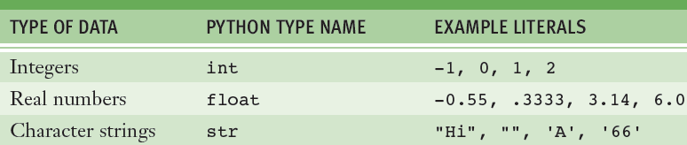

Python Data Types
A data type consists of a set of values and a set of operations that can be performed on those values
A literal is the way a value of a data type looks to a programmer
int and float are numeric data types

Slide 14
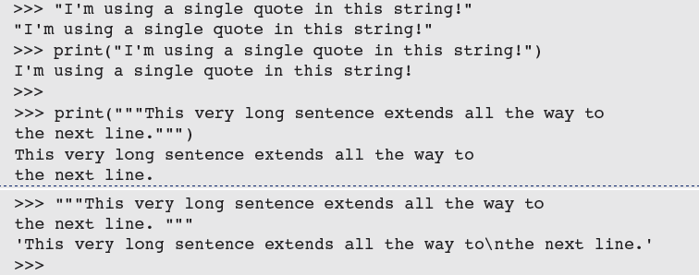
String Literals
In Python, a string literal is a sequence of characters enclosed in single or double quotation marks
'' and "" represent the empty string
Use ''' and """ for multi-line paragraphs

Slide 15
Escape Sequences
The newline character \n is called an escape sequence

Slide 16

String Concatenation
You can join two or more strings to form a new string using the concatenation operator +
The * operator allows you to build a string by repeating another string a given number of times

Slide 17
Variables and the Assignment Statement
A variable associates a name with a value
Makes it easy to remember and use later in program
Variable naming rules:
Reserved words cannot be used as variable names
Examples: if, def, and import
Name must begin with a letter or _
Name can contain any number of letters, digits, or _
Names are case sensitive
Example: WEIGHT is different from weight
Tip: use “camel casing” (Example: interestRate)

Slide 18
Variables and the Assignment Statement
Programmers use all uppercase letters for symbolic constants
Examples: TAX_RATE and STANDARD_DEDUCTION
Variables receive initial values and can be reset to new values with an assignment statement
<variable name> = <expression>
Subsequent uses of the variable name in expressions are known as variable references

Slide 19
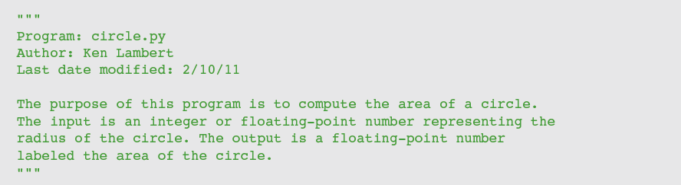
Program Comments and Docstrings
Docstring example
End-of-line comment example:

Slide 20
Numeric Data Types and Character Sets
The first applications of computers were to crunch numbers
The use of numbers in many applications is still very important

Slide 21
Integers
In real life, the range of integers is infinite
A computer’s memory places a limit on magnitude of the largest positive and negative integers
Python’s int typical range: –2³¹ to 2³¹ – 1
Integer literals are written without commas

Slide 22
Floating-Point Numbers
Python uses floating-point numbers to represent real numbers
Python’s float typical range: –10³⁰⁸ to 10³⁰⁸ and
Typical precision: 16 digits

Slide 23
Character Sets

Slide 24
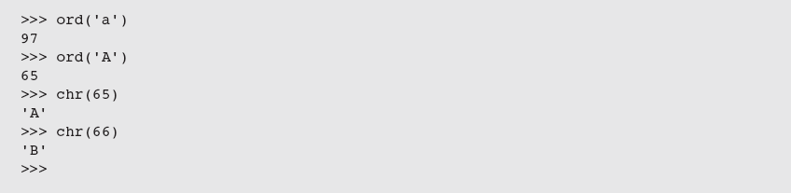
Character Sets
In Python, character literals look just like string literals and are of the string type
They belong to several different character sets, among them the ASCII set and the Unicode set
ASCII character set maps to set of integers
ord and chr convert characters to and from ASCII

Slide 25
Expressions
A literal (e.g. “Python is cool”) evaluates to itself
A variable reference evaluates to the variable’s current value
Expressions provide easy way to perform operations on data values to produce other values
When entered at Python shell prompt:
an expression’s operands are evaluated
its operator is then applied to these values to compute the value of the expression

Slide 26
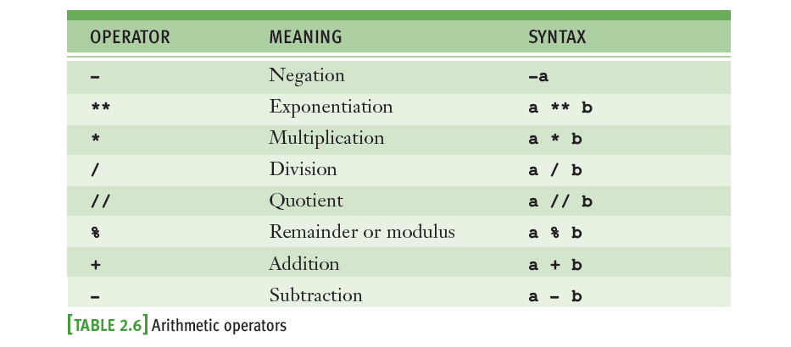
Arithmetic Expressions
An arithmetic expression consists of operands and operators combined in a manner that is already familiar to you from learning algebra

Slide 27
Arithmetic Expressions
Precedence rules:
** has the highest precedence and is evaluated first
Unary negation is evaluated next
*, /, and % are evaluated before + and -
+ and - are evaluated before =
With two exceptions, operations of equal precedence are left associative, so they are evaluated from left to right
** and = are right associative
You can use () to change the order of evaluation

Slide 28
Arithmetic Expressions
45%0 is a semantic error

Slide 29
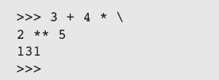
Arithmetic Expressions
When both operands of an expression are of the same numeric type, the resulting value is also of that type
When each operand is of a different type, the resulting value is of the more general type
Example: 3 / 4 is 0, whereas 3 / 4.0 is .75
For multi-line expressions, use a \

Slide 30
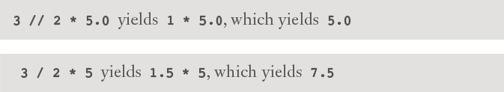
Mixed-Mode Arithmetic and Type Conversions
Mixed-mode arithmetic involves integers and floating-point numbers:
Remember—Python has different operators for quotient
and exact division:
Tip:
Use exact division
Use a type conversion function with variables

Slide 31
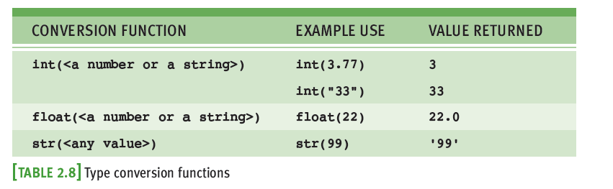
Mixed-Mode Arithmetic and Type Conversions

Slide 32
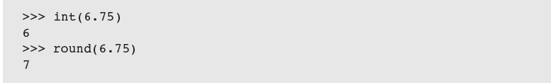
Mixed-Mode Arithmetic and Type Conversions
Note that the int function converts a float to an int by truncation, not by rounding

Slide 33
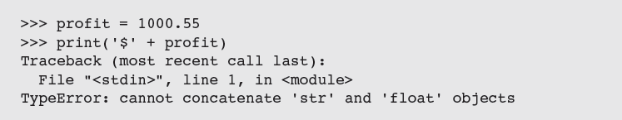
Mixed-Mode Arithmetic and Type Conversions
Type conversion also occurs in the construction of strings from numbers and other strings
Solution: use str function
Python is a strongly typed programming language – the interpreter checks data types before operations are applied.

Slide 34
Exercise
In each of the projects below you should write a program that contains an introductory docstring. This documentation should describe what the program will do (analysis) and how it will do it. Include suitable prompts for all inputs, an label all outputs appropriately. After you have coded a program, be sure to test it with a reasonable set of legitimate inputs.
Write a program that calculates and prints the number of minutes in a year.
Light travels at 3 * 10⁸ meters per second. A light-year is the distance a light beam travels in one year. Write a program that calculates and displays the value of light year.

Slide 35
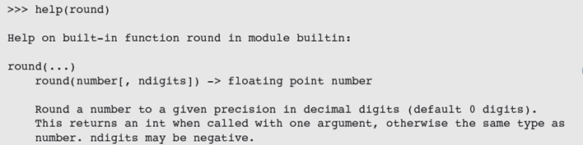
Calling Functions: Arguments and Return Values
Python includes many useful functions, which are organized in libraries of code called modules
A function is chunk of code that can be called by name to perform a task
Functions often require arguments or parameters
Arguments may be optional or required
When function completes its task, it may return a value back to the part of the program that called it

Slide 36
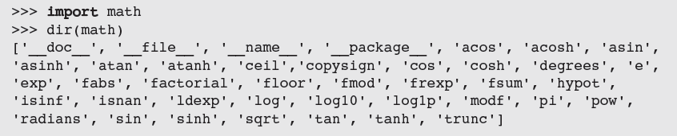
The math Module
To use a resource from a module, you write the name of a module as a qualifier, followed by a dot (.) and the name of the resource
Example: math.pi

Slide 37

The math Module
You can avoid the use of the qualifier with each reference by importing the individual resources
You may import all of a module’s resources to use without the qualifier
Example: from math import *

Slide 38
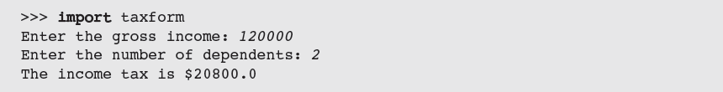
The Main Module
In the case study, earlier in this chapter, we showed how to write documentation for a Python script
To differentiate this script from the other modules in a program, we call it the main module
Like any module, the main module can be imported

Slide 39
The Main Module

Slide 40
Program Format and Structure
Start with comment with author’s name, purpose of program, and other relevant information
In a docstring
Then, include statements that:
Import any modules needed by program
Initialize important variables, suitably commented
Prompt the user for input data and save the input data in variables
Process the inputs to produce the results
Display the results

Slide 41
Running a Script from a Terminal Command Prompt

Slide 42
Running a Script from a Terminal Command Prompt

Slide 43
Running a Script from a Terminal Command Prompt
Python installations enable you to launch Python scripts by double-clicking the files from the OS’s file browser
May require .py file type to be set
Fly-by-window problem: Window will close automatically
Solution: Add an input statement at end of script that pauses until the user presses the enter or return key

Slide 44
Summary
Waterfall model describes software development process in terms of several phases
Literals are data values that can appear in program
The string data type is used to represent text for input and output
Escape characters begin with backslash and represent special characters such as delete key
A docstring is string enclosed by triple quotation marks and provides program documentation

Slide 45
Summary
Comments are pieces of code not evaluated by the interpreter but can be read by programmers to obtain information about a program
Variables are names that refer to values
Some data types: int and float
Arithmetic operators are used to form arithmetic expressions
Operators are ranked in precedence
Mixed-mode operations involve operands of different numeric data types

Slide 46
Summary
A function call consists of a function’s name and its arguments or parameters
May return a result value to the caller
Python is a strongly typed language
A module is a set of resources
Can be imported
A semantic error occurs when the computer cannot perform the requested operation
A logic error produces incorrect results

Slide 47
Exercise
In each of the projects below you should write a program that contains an introductory docstring. This documentation should describe what the program will do (analysis) and how it will do it. Include suitable prompts for all inputs, an label all outputs appropriately. After you have coded a program, be sure to test it with a reasonable set of legitimate inputs.
Five Star Video rents new videos for $3.00 a night, and oldies for $2.00 a night. Write a program that the clerks at Five Star Video can use to calculate the total charge for a customer’s video rental. The program should prompt the user for the number of each type of video and output the total cost.
An employee’s total weekly pay equals the hourly wage multiplied by the total number of regular hours plus any overtime pay. Overtime pay equals the total overtime hours multiplied by 1.5 times the hourly wage. Write a program that takes as inputs the hourly wage, total regular hours and total overtime hours and displays an employee’s total weekly page.

